Slide 1
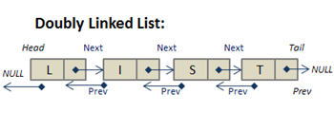
Linked Lists

Slide 2
Today
Check In
Quizzes - halfway done
Goals
Explain and compare different implementations of linked lists, including singly linked, doubly linked, circular, and those with dummy head nodes.
Analyze when to use linked lists vs. Java’s ArrayList<E> or LinkedList<E>.

Slide 3
Define Class in a Class
Why define Node inside the list class?
Because the Node class:
Is only used by the list and it doesn’t need to exist anywhere else.
Keeps implementation details hidden from outside code.
This is part of encapsulation: the Node is an internal helper object.
Think of it as a part of the list — not something other classes should reference directly.
class SinglyLinkedList{
Node head;
private static class Node{
int data;
Node next;
public Node(int data){
this.data = data;
this.next = null;
}
}
}

Slide 4
Class Node: private and static
Node is a small helper class used only inside the linked list.
It keeps the list self-contained, efficient, and easy to maintain.
Keyword | Meaning | Why We Use It
class Node | Defines the data “building block” for the list | Holds data and a next link
private | Hidden from other classes | Keeps list details internal (encapsulation)
static | Doesn’t access outer class fields | Simpler, no extra link to outer object

Slide 5
Singly Linked List Review
What is a singly linked list?
Why do we track previous and current?
How does insertNode() and deleteNode() work in a singly linked list when inserting in order?
//Define a Node
class Node {
int data;
Node next;
public Node(int data){
this.data = data;
this.next = null;
}
}
public void deleteNode(int number) {
Node current = head;
Node previous = null;
while (current != null && current.data != number) {
previous = current;
current = current.next;
}
if (current != null) {
if (previous == null) {
head = current.next;
} else {
previous.next = current.next;
}
}
}
public void insertNode(int number){
Node newNode = new Node(number);
Node current = head;
Node previous = null;
while (current != null && current.data < number) {
previous = current;
current = current.next;
}
if (previous == null) {
newNode.next = head;
head = newNode;
} else {
previous.next = newNode;
newNode.next = current;
}
}
Think about the runtime to insert at the end of the list. It will be O(n), since we must traverse all the way from head.

Slide 6
Singly Linked List with Tail
class SinglyLinkedList {
Node head;
Node tail;
}
Add a tail Node to be tracked in a SinglyLinkedList
We still have one-directional links (next only).
But the list class keeps both ends tracked.
//without tail (O(n))
public void insertAtEnd(int value) {
Node newNode = new Node(value);
if (head == null) head = newNode;
else {
Node current = head;
while (current.next != null)
current = current.next;
current.next = newNode;
}
}
//with tail (O(1))
public void insertAtEnd(int value) {
Node newNode = new Node(value);
if (head == null) head = tail = newNode;
else {
tail.next = newNode;
tail = newNode;
}
}
By tracking the tail O(1) insertion at the end.

Slide 7
Insert with Tail
public void insertNode(int number) {
Node newNode = new Node(number);
if (head == null) {
head = tail = newNode;
return;
}
if (number <= head.data) {
newNode.next = head;
head = newNode;
return; // tail unchanged
}
if (number >= tail.data) {
tail.next = newNode;
tail = newNode;
return;
}
NodeFix previous = null;
NodeFix current = head;
while (current != null && current.data < number) {
previous = current;
current = current.next;
}
previous.next = newNode;
newNode.next = current;
}
Case 1: empty list
Case 2: insert at head (new smallest) and tail doesn’t change
Case 3: insert at tail (new largest)
Case 4: insert in the middle
Connect both sides: previous -> newNode -> current
Tails stays the same

Slide 8
Delete with Tail
public void deleteNode(int number) {
if (head == null) {
return;
}
if (head.data == number) {
head = head.next;
if (head == null) {
tail = null;
}
return;
}
NodeFix previous = head;
NodeFix current = head.next;
while (current != null && current.data != number) {
previous = current;
current = current.next;
}
if (current == null) {
return;
}
previous.next = current.next;
if (current == tail) {
tail = previous;
}
}
Case 1: Empty List
Case 2: delete head
Case 3: Traverse to find node to delete, keeping track of previous
Case 4: not found
Case 3: Must unlink the current and If removing the tail node, move tail back to 'previous'

Slide 9
Edge Cases
Even with a tail, deletion still requires traversal (we can’t move backward
Case | Action
Empty list | head = tail = newNode;
Delete last node | Must traverse to find the new tail
Insert at head | newNode.next = head; head = newNode; no tail change
We can insert efficiently at the end, but can we delete efficiently at the end?

Slide 10
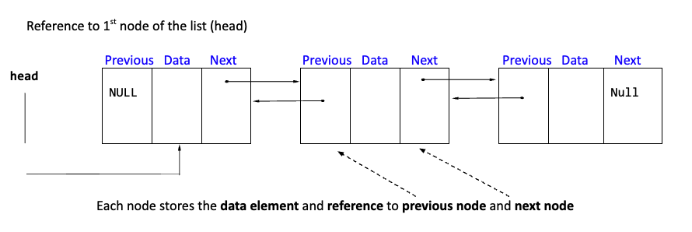
Doubly Linked List
There are also doubly linked lists where each node contains three parts:
Data field
The information the node holds
Previous field
A reference to the previous node in the list
First node’s previous reference is NULL
Next field
A reference to the next node in the list
Last node’s next reference is NULL
Doubly Linked List: Allows traversal in both directions.
Explore inserting and removing from a Doubly Linked list https://visualgo.net/en/list. Pay attention to the head and the tail.

Slide 11
Doubly Linked List Applications
Application | How It Uses a Doubly Linked List
Operating Systems (Task Scheduling) | Processes running tasks, switching efficiently between them.
Music & Video Playlists | Tracks songs or videos, allowing forward and backward navigation.
Database Transactions | Manages ACID transactions, storing rollback points for consistency.
Game Development (Player Movement in 2D/3D) | Handles movement in 2D/3D space where objects can move forward or backward.
Blockchain (Double-Linked Structure for Blocks) | Maintains blockchain data by linking blocks bidirectionally.
Memory Management (Heap & Paging) | Manages memory blocks, allowing quick allocation and deallocation.

Slide 12
Doubly Linked List Lab
Download and import DoubleLinkedListLab.java - this is not keeping the elements ordered.
Design implement using test driven development. What are the different scenarios and the parts of the algorithm? Implement a little bit of code and test.
Debug the existing code to how print forward and insertion at the end works
Design how the insertAtHead() will be different from insertion at the end
What are the different scenarios?
Implement insertAtHead() code a little at a time and test
Design how to implement deleteNode()
What are the different scenarios?
Implement insertAtHead() code a little at a time and test
Design reverseList and implement
Design print Backward and implement
Handle edge cases: empty list, single node, head/middle/tail deletes

Slide 13
Hints
Implementing insertAtHead
If the list is empty, set head = newNode.
Otherwise, update:
newNode.next = head
head.prev = newNode
head = newNode
Implement ReverseList
Swap next and prev for each node.
Move head to the last node.
Implement deleteNode
Find the node with value data.
If deleting the head, update head = head.next and set head.prev = null.
Otherwise, unlink the node by:
previous.next = current.next
If current.next is not null, set current.next.prev = previous

Slide 14
Singly Linked List vs Doubly Linked List
Singly linked list deletions are simpler because they only require updating next pointers.
Doubly linked lists require extra steps to ensure the prev pointers remain correct.
If bidirectional traversal is needed, a doubly linked list is better.
If minimal memory and simplicity are priorities, a singly linked list is better.
Feature | Singly Linked List | Doubly Linked List
Pointer Structure | Only has next | Has both next and prev
Tracking Previous Node | Needed to update previous.next | Needed to update previous.next and current.next.prev
Node Removal | previous.next = current.next | previous.next = current.next & current.next.prev = previous
Deleting the Head | head = current.next | head = current.next, and head.prev = null
Looping Mechanism | Iterates forward only | Iterates forward, but prev allows backward traversal
Efficiency | Slightly faster (fewer pointers) | More flexible but requires extra updates

Slide 15
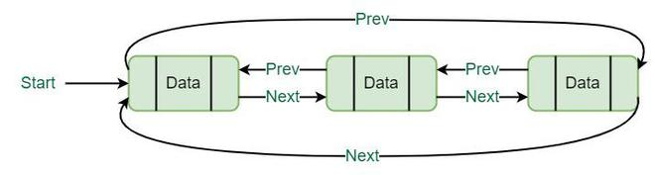
Circular Doubly Linked Lists
A circular doubly linked list is a doubly linked list where:
The last node’s next pointer points back to the first node (instead of null).
The first node’s prev pointer points to the last node.
No null at the beginning or end (the list loops back).
Traversal can continue infinitely in both directions.
Efficient for cyclic operations (e.g., round-robin scheduling).
next of last node (30) → first node (10)
prev of first node (10) → last node (30)
10
20
30

Slide 16
Doubly Linked List Applications
Circular doubly linked lists are useful when continuous looping is required.
Application | How It Uses a Circular Doubly Linked List
Music Playlists | Loops through songs indefinitely, allowing "repeat mode"
Operating System (OS) Scheduling | Round-robin CPU scheduling cycles through tasks
Multiplayer Games | Keeps track of players in a circular turn-based game
Cache Management | Implements Least Recently Used (LRU) caching
Carousel Menus in UI | Loops through images or options endlessly

Slide 17
(OPTIONAL LAB) Creating a Circular Doubly Linked List Lab
Step 1: Modify the DoublyLinkedList class
Implement the method makeCircular() to:
Find the last node in the list.
Update last.next to point to head.
Update head.prev to point to last.
Step 2: Modify the printCircular() method
Ensure traversal stops when reaching the start node again.
Step 3: Test the changes
Insert nodes, convert to circular, and print the list.

Slide 18
Linked List with a Dummy Head Noden (Won’t be implementing)
A dummy head node is a special type of linked list where an extra node (the "dummy head") is always present at the start of the list. Unlike a regular head node, the dummy head does not store meaningful data but serves as a placeholder to simplify list operations.
Always Present: The dummy head node is always part of the list.
Does Not Store Real Data: Usually initialized with a placeholder value (e.g., -1 or null).
Simplifies Insertions & Deletions: Since the list always has a head, you don’t need to check if head == null before modifying the list.
Ensures Consistent List Structure: The first real node is always after dummyHead.next, making modifications more uniform.
Feature | Without Dummy Head | With Dummy Head
Handling Empty List | Must check if (head == null) before insert/delete | No special checks needed (list always starts with a dummy)
Insertion at Head | Requires separate logic to update head | Always insert after dummyHead
Deletion at Head | Requires handling head = head.next separately | Simply update dummyHead.next
Code Complexity | More conditional checks needed | Simpler, more consistent code

Slide 19
Summary of Linked Lists
A linked list is a dynamic data structure that consists of nodes where each node stores:
Data (the actual value stored)
Pointer(s) to the next (and sometimes previous) node
Unlike arrays, linked lists do not require contiguous memory, making insertion and deletion more efficient in certain cases.
Types of Linked List | GeeksforGeeks
Feature | Singly Linked List | Doubly Linked List | Circular Linked List
Traversal | One direction | Both directions | Circular traversal
Memory Overhead | Low | High (extra pointer) | Similar to SLL/DLL
Insertion/Deletion | Harder (must track previous node) | Easier (can modify prev/next) | Requires circular connection
Use Cases | Stacks, queues, chaining | Undo/redo, navigation | Round-robin scheduling, cyclic processing

Slide 20
Linked List Class Lab
Java provides a built-in LinkedList<E> class as part of the Java Collections Framework.
Lists Abstract Data Type
add(E element) – adds to the end.
add(int index, E element) – inserts at specific index.
remove() / remove(int index) – removes from front or at index.
get(int index) – retrieves item at index.
size() – returns current number of elements.
clear() – removes all elements.
contains(E element) – checks if the list contains the element.
isEmpty() – checks if list is empty.
When you understand linked lists from the inside,
you can use Java’s collections more intelligently — you know what’s happening under the hood.
import TaskManagerDemo.java Now that you’ve manually implemented insertAtHead, insertAtEnd, and deleteNode, how do those ideas appear in the built-in methods you just used?
Which methods behave like your insertAtEnd? (add)
Which ones are like deleteNode? (remove)
How does Java handle head and tail behind the scenes?.

Slide 21
Preparation
Work on your project next and use the project examples in your tech doc to summarize your learnings. After your project finish labs for doubly linked list and linked list class then update technical documentation with these concepts.
Review SinglyLinkedList Implementation and your technical documentation based on the lab you did to implement a queue using an arraylist. You are going to implement the queue for the project as a singly linked list. The Playlist Library Manages songs in two collections:
An ArrayList<Song> for the full library of songs (loaded from CSV).
A SinglyLinkedList<Song> for the Up-Next queue.
Team Discussion
How does a queue work?
What operations should a queue have?
What happens to the head and tail when you add or remove items?
How will you handle an empty queue?
What are various test cases to help you design and test your implementation?

